Slide 1
Luke 2:8-20
⁸And there were shepherds living out in the fields near by, keeping watch over their flocks at night. ⁹An angel of the Lord appeared to them, and the glory of the Lord shone around them, and they were terrified. ¹⁰But the angel said to them, “Do not be afraid. I bring you good news of great joy that will be for all the people. ¹¹Today in the town of David a Saviour has been born to you; he is Christ the Lord.
¹²This will be a sign to you: You will find a baby wrapped in cloths and lying in a manger.”

Slide 2
Luke 2:8-20
¹³Suddenly a great company of the heavenly host appeared with the angel, praising God and saying,
¹⁴“Glory to God in the highest,
and on earth peace to men on whom his favour rests.”
¹⁵When the angels had left them and gone into heaven, the shepherds said to one another, “Let’s go to Bethlehem and see this thing that has happened, which the Lord has told us about.”

Slide 3
Luke 2:8-20
¹⁶So they hurried off and found Mary and Joseph, and the baby, who was lying in the manger. ¹⁷When they had seen him, they spread the word concerning what had been told them about this child, ¹⁸and all who heard it were amazed at what the shepherds said to them.
¹⁹But Mary treasured up all these things and pondered them in her heart. ²⁰The shepherds returned, glorifying and praising God for all the things they had heard and seen, which were just as they had been told.

Slide 6
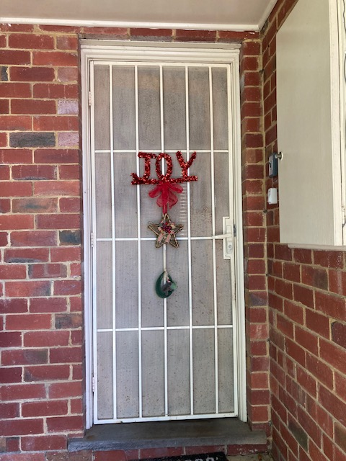

Slide 8
Joy
Joy in the first Christmas Story
Angel I bring you good news of great joy
Angels Great heavenly host praising God - Glory to God
Shepherds Glorifying and praising God
Mary Treasured up all these things and pondered them in her heart
Wise Men - Were overjoyed and worshipped Christ

Slide 9
Joy
Joy in the first Christmas Story Luke 2:12-20
Angel ¹⁰But the angel said to them, “Do not be afraid. I bring you good news of great joy that will be for all the people.
Joy is different to happiness

Slide 10
Joy
Joy in the first Christmas Story Luke 2:12-20
Angels ¹³Suddenly a great company of the heavenly host appeared with the angel, praising God and saying,
¹⁴“Glory to God in the highest,
and on earth peace to men on whom his favour rests.”
Joy is a deeper sense of inner peace and assurance

Slide 11
Joy
Joy in the first Christmas Story Luke 2:12-20
Shepherds ¹⁷When they had seen him, they spread the word concerning what had been told them about this child, ¹⁸and all who heard it were amazed at what the shepherds said to them.
Joy is contagious

Slide 12
Joy
Joy in the first Christmas Story Luke 2:12-20
Mary ¹⁹But Mary treasured up all these things and pondered them in her heart
Joy can co-exist with sorrow

Slide 13
Joy
Joy in the first Christmas Story Matthew 2:1-12
Wise Men ¹⁰When they saw the star, they were overjoyed. ¹¹On coming to the house, they saw the child with his mother Mary, and they bowed down and worshipped him. Then they opened their treasures and presented him with gifts of gold and of incense and of myrrh.
Joy is a choice

Slide 14
Joy
Alex’s story of JOY

Slide 15
to do list
IMPORTANT
Take Note
Creation
Blank pages
large and small

Slide 16
How can we experience joy in difficult times?
How can we cultivate joy in our daily lives?

